Slide 1

Google Store Predictive Analysis
By Susan Mensah

Slide 2
Google Predictive Analysis – A Kaggle Competition
Problem Statement:
Predicting how much customers will spend at a google store.
Risks & Assumptions:
Risk involved was minimal, some of which involved not having sufficient time to try out all intended processes.
Insufficient computational power to run models.

Slide 3
Proposed Methods and Models
Our data set contains a label, thus a supervised machine learning problem. we will be trying out different supervised models to find out which one is best.
Since we are working with a continuous variables, it is appropriate to use regression models .
For checking our accuracy, we would use Root Mean Square Error metric to check how well our model is doing.
With this metric, the closer we are to zero for both our testing and training data, the better are model is doing.
To ensure that our data is equally scaled, a Standard Scalar scaling will be applied at all times.

Slide 4
Data Source
Data - Given on Kaggle.
Data-size for training = 1,468,195 KB;
Data-size for test = 1,315,279 KB;
Data format = .csv;
Number of rows = 903653
There are some json objects with some of the columns in the dataset

Slide 5
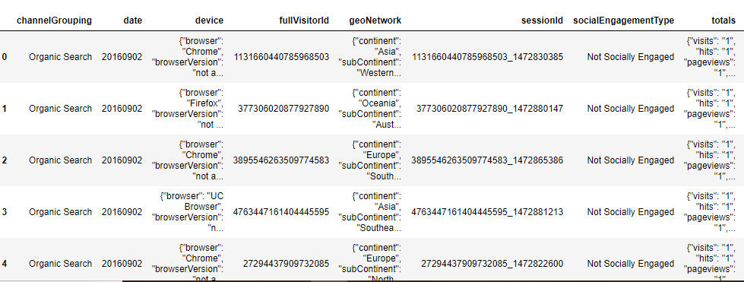
Sample Data Set

Slide 6
Exploratory Data Analysis
Dropped Columns: I looked at each column closely and columns that had consistently the same value for each observation or didn't seem to place much relevance or had the same data present in another column were dropped.
Such columns include:['browserSize', 'browserVersion', 'flashVersion', 'language', 'mobileDeviceBranding', 'mobileDeviceInfo', 'mobileDeviceMarketingName', 'mobileDeviceModel', 'mobileInputSelector', 'operatingSystemVersion', 'screenColors', 'screenResolution', 'visits','adwordsClickInfo', 'campaignCode','socialEngagementType','networkLocation', 'longitude', 'latitude', 'cityId', 'metro', 'country', 'region', 'subContinent', 'isMobile', 'medium']

Slide 7
Exploratory Data Analysis
Fill Nan’s: Nan's for categorical variables with -999 and numerical variables with 0.
This was done because I did not want the categorical columns affected much when I “get dummies” on them turning them to `1s` and `0s`.
Also the missing values in the numerical columns for example, transactionRevenue might hold the same relevance as the value 0, because in both cases we might say no transaction or actual sale was made when customer visited the site.
We could say that the customer left the site without checking through the merchandise in the store or did not get to the store page.

Slide 8
Exploratory Data Analysis
Json Script: For each column that has a json script imbeded, I transform them into a data frame.
For example, df['totals’].
Once the column has been turned into a data frame. some more EDA is done by deleting columns that would play any effect on our model either because its the same for all rows or completely empty or has no value.
After EDA, this column is added to the main data frame while the previous json column is dropped to avoid any duplicates. The total column is illustrated below.

Slide 9
Y-label
Within the totals column is transactionRevenue, our y-label.
This is what will be used to train our model and predict transactionRevenue for our kaggle test data.

Slide 10
Y-label
We have 903653 observations (rows) in our data set. However, 11515 of that actually is not null in the transactionRevenue column. We have a very unbalance class.
These values, are rounded to the 1,000,000 unit, hence, we have to divide by 1,000,000 to get our values to 1unit values that we can relate with adequately.
Dividing the transactionRevenue column by number transforms the column from and object to a number stored as float.

Slide 11
Y-label (transactionRevenue)
Min Amount Spent
Max Amount Spent
468262 $0.01
181497 $0.04
396053 $ 0.09
762377 $0.16
181509 $0.20
375253 $23129.50
430822 $17855.50
380988 $16023.75
773715 $10589.14
891576 $8677.83
The Minimum amount spent is $0.01
The maximum amount spent is $23,129.50

Slide 12
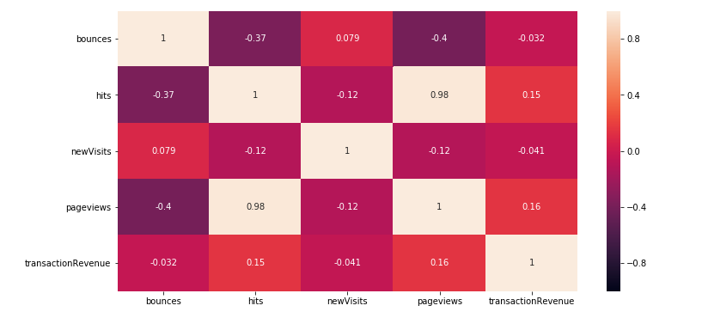
Correlation
Pageview had the strongest correlation followed by hits

Slide 13
Correlation
Pageview had the strongest correlation followed by hits
pageviews 0.155589
hits 0.154333
visitNumber 0.051366
visitStartTime 0.002724
visitId 0.002724
fullVisitorId -0.000061
sessionId -0.000061
bounces -0.032206
newVisits -0.041164

Slide 14
Base Modeling Using “totals” Data Frame
Linear Regression
Train Score - 0.025320631161857787
Test Score - 0.027986778883331453
RMSE:
Train: 52.933224339226555
Test: 49.474343978373

Slide 15
Base Modeling Using “totals” Data Frame
RidgeCV Regression
(0.02679019121269599, 0.028680174548972093)
LassoCV Regression
(0.027089164390251996,
0.029184380531635412)
RMSE LassoCV:
Train: 52.885179478075145
Test: 49.44385631818874

Slide 16
More EDA
Although our model slightly improved, it wasn't by much. It is still showing some bias so I made the model a bit more complex by adding the categorical features.
Once all the necessary columns were dropped we were left with 16 columns of which 6 were categorical. These were further transformed into dummies creating 496 new columns. A combined total of 506 columns and 903653 rows.

Slide 17
Modeling Using “Cat & Num” Features
Linear Regression
Train Score – (- 0.02798355943529396)
Test Score - (1.1352755306492406e+26)
RMSE:
Train: 52.86086526730443
Test: 534680809415504.75

Slide 18
Modeling Using “Cat & Num” Features
LassoCV Regression
(0.028095641353674154,
0.029466466384250323)
RMSE LassoCV:
Train: 52.85781752153458
Test: 49.43667244856717

Slide 19
Top Lasso Coefficients
Variables Coefficient
pageviews 7.297421
visitNumber 2.244989
bounces 1.914733
hits 1.501596
source_dfa 0.920334

Slide 20
Comparing models listed and their performances
LinearRegression
DecisionTreeRegressor
ExtraTreesRegressor
RandomForestRegressor
AdaBoostRegressor
GradientBoostingRegressor
Simple Vector Machine

Slide 21
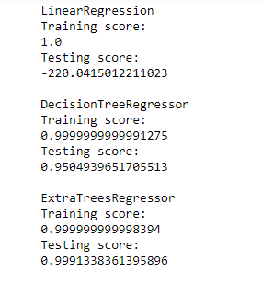
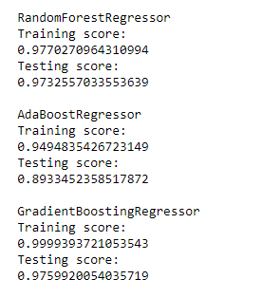
Comparing Models

Slide 22
Comparing models listed and their performances
Our findings reveal, Linear Regrssion to be grossly overfitting. The other models show some overfitting but not by much. ExtraTressRegressor seem to have the best score and least overfitting going on with regards to the other CARTs

Slide 23
Modeling Using Gradient Boosting
RMSE:
Train: 0.4174781074857505
Test: 4.5332287915270895

Slide 24
Summary
We began with trying to predict the how much customers will spend at a gStore.
We analyzed our data, performed some EDA and dropped the necessary columns.
We then tried predicting on just on numerical columns and found that to be adequately lacking.
In turn we tried predicting on all remaining columns both numerical and categorical columns and found that our model performed much better. Although we are scoring at 99% on some of our models, there is still room for improvement on our model.

Slide 25
Suggested Improvements
Since there is overfitting occuring, we might try to reduce the variance by making our model less complex.
We might consider using only the top five impactful variables especially outlined by our LassoCV coeffients.

Slide 26
Overall Outcome
We could potentially use this model to predict how much a customer will spend on any ecommerce store with similar data collection.

